Slide 1
Kindle Review Analysis
Julia Showl

Slide 2

Introduction
Kindle is Amazon’s self publishing e-book platform
Customer reviews allow for readers to make informed decisions on whether or not to purchase a book

Slide 3




Technology
PostgreSQL
MongoDB
Python
Jupyter Lab

Slide 4
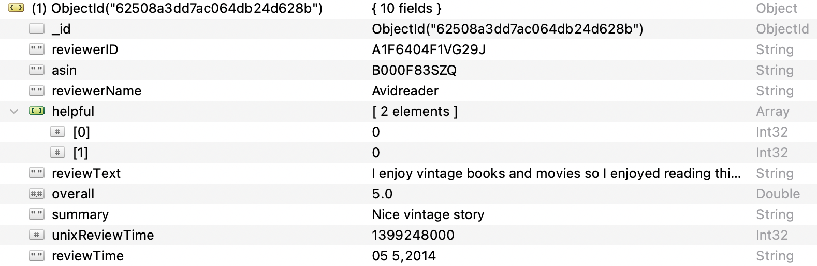
Mongo Schema
All of the data goes into a single collection

Slide 5
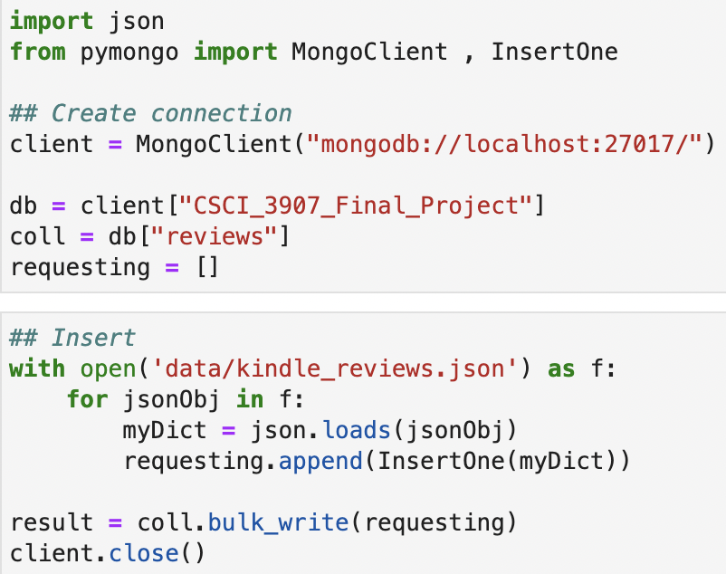
Mongo Insertion
Pros
Easy insertion
Cons
Redundancy of users and products

Slide 6
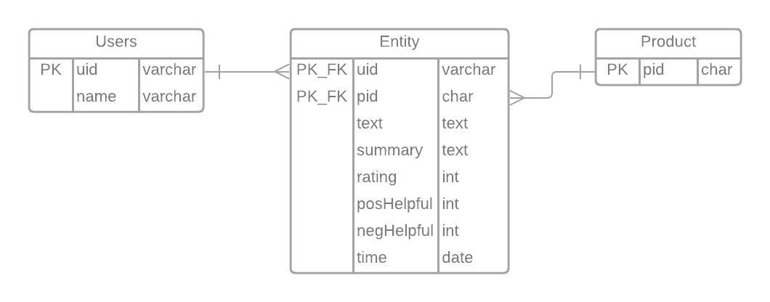
Postgres Schema
*Unix Review Time was not included

Slide 7
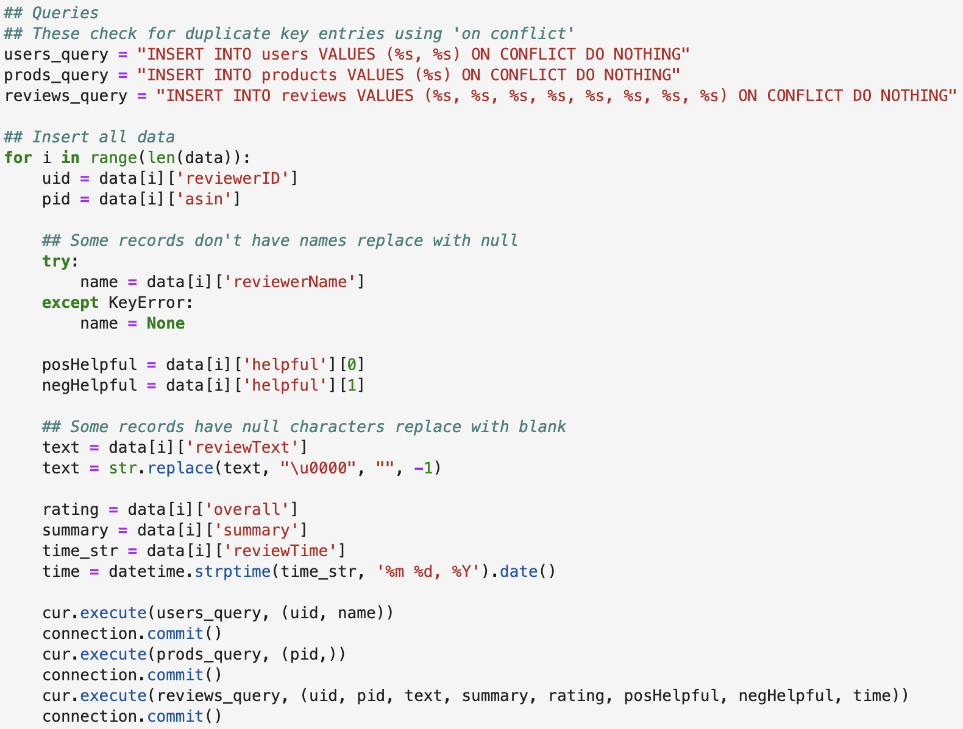
Postgres Insertion
Pros
Easy querying of users or products
No duplicate entries
Cons
Slow insertion

Slide 8
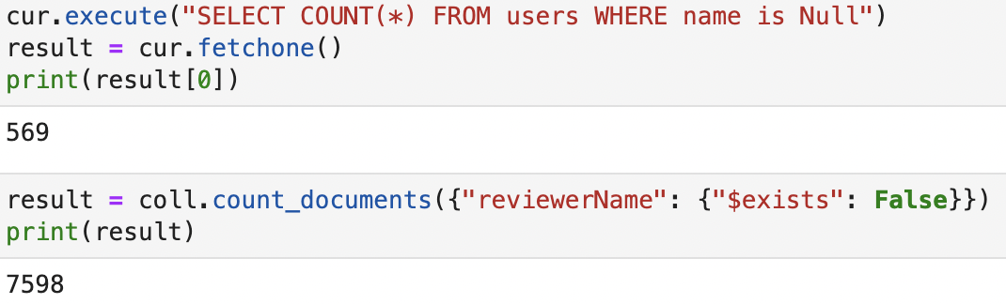
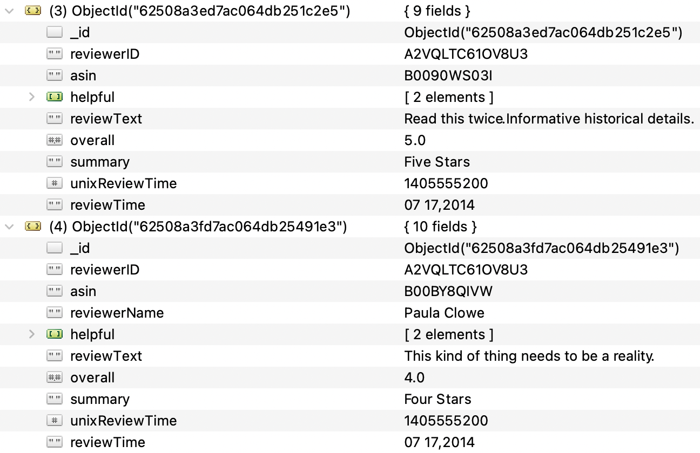
Mongo and Postgres
Querying for unique data in Mongo can be difficult
Some data can be changed later in but not picked up by Postgres insertion
Can be remedied by changing insertion from “ON CONFLICT DO NOTHING” to “ON CONFLICT DO UPDATE”

Slide 9
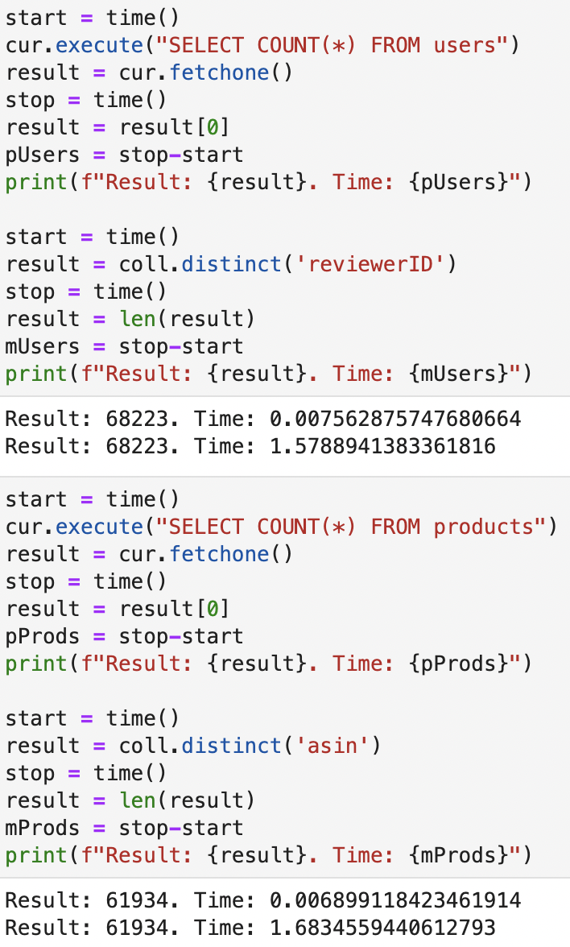
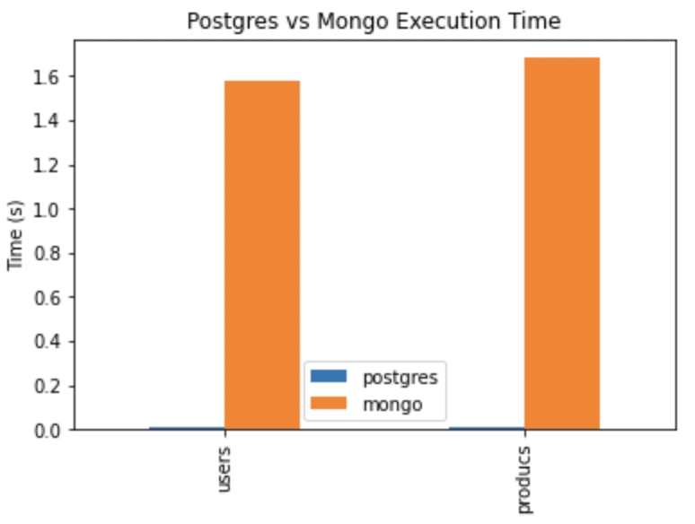
Mongo and Postgres
Querying for unique data in Mongo will take significantly longer

Slide 10
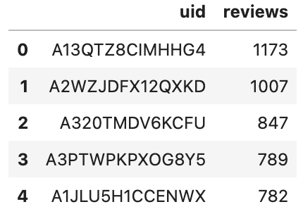
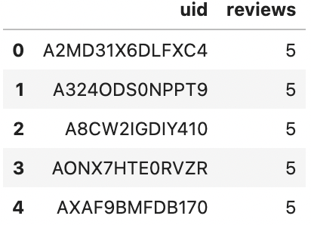
Analysis - Users
Are top reviewers more likely to leave a higher rating compared to the bottom reviewers?

Slide 11
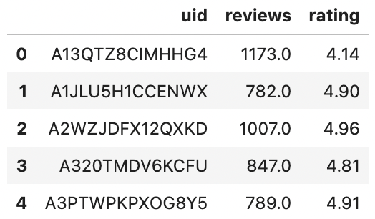
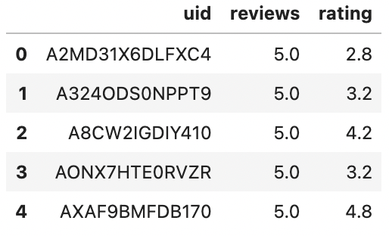
Analysis - Users
Users who review books less frequently are more likely to be dissatisfied
Average for top 5 reviewers 4.74
Average for bottom 5 reviewers 3.64

Slide 12
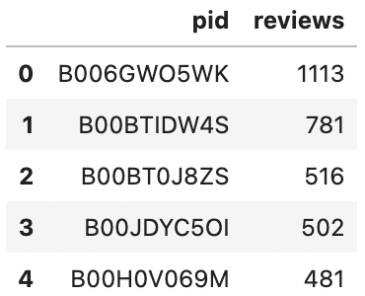


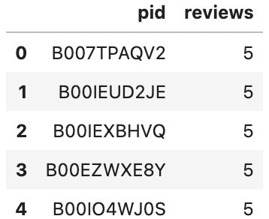







Analysis - Products
Do products with a higher frequency of reviews have a higher average rating?
B00H0V069M
B00EZWXE8Y
B00BTIDW4S
B00BT0J8ZS
B00JDYC5OI
B00IEXBHVQ
B00IEUD2JE
B007TPAQV2
*Could not find B006GWO5WK
B00IO4WJ0S

Slide 13
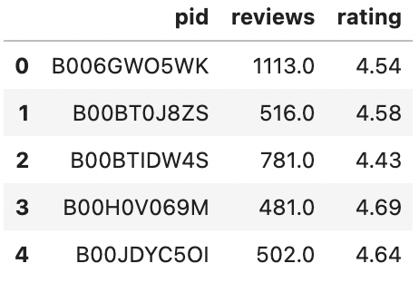
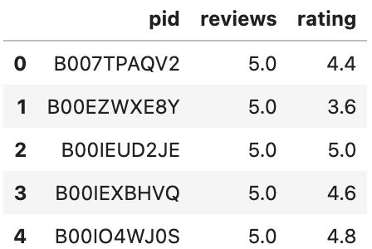
Analysis - Products
Average rating is 4.576
Average rating is 4.48

Slide 14
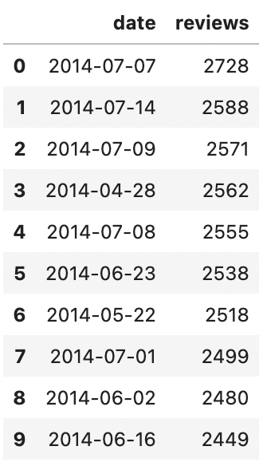
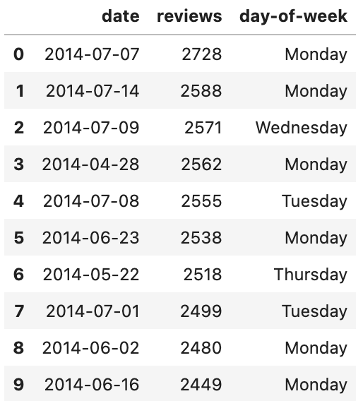
Analysis - Reviews
Is there a day when reviews are more likely to be posted?
Yes! It is more likely that reviews are written on Mondays. In general reviews are more likely to occur in the first half of the week opposed to the second half.

Slide 15
Conclusions
Postgres can be faster when querying unique data
Mongo can account for updated accounts but may insert unique data, like IDs, more than once
Updating Postgres rows on conflict should resolve this
Customers who do not review a lot of products are likely to rate the product lower than customers who review products frequently
Products with more reviews are not necessarily reviewed higher
Mondays seem to be a popular time to get your Kindle review in

Slide 16
Thank you!

